Slide 1
Truman Team 1
Nabin Karki, Caleb Jones, Mengqing Zhang, and Rudy Nartker

Slide 2
How can we recommend career paths to High School seniors based on the data from today’s Job market?

Slide 3
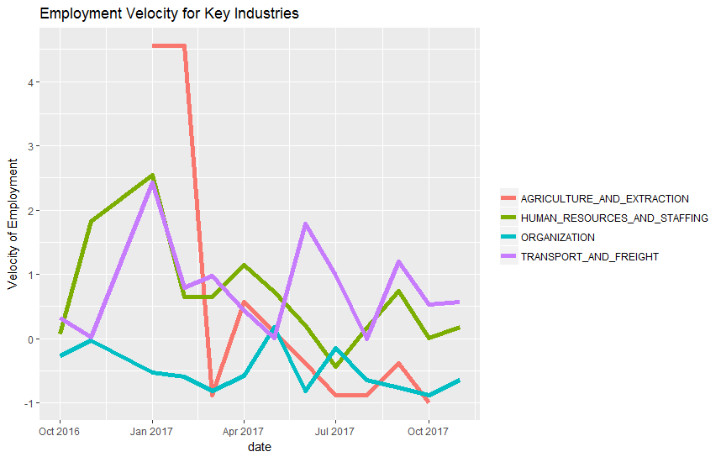
Employment Velocity is standardized and reported by month
HR and Staffing along with Transportation and Freight have the highest Employment Velocity
The grand mean(Z=0) is cumulated across all industries
Agriculture and Extraction is somewhat of an outlier

Slide 4
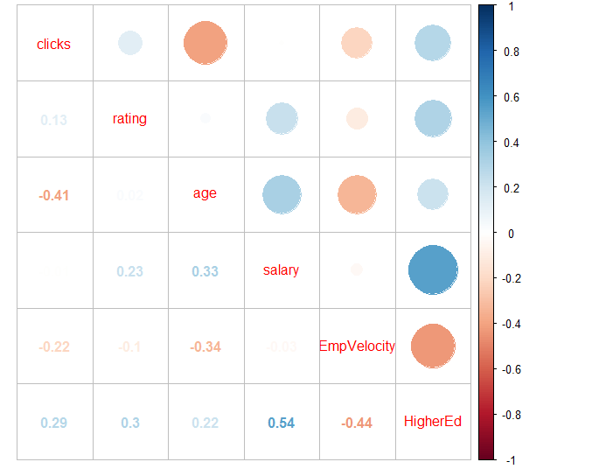
Variable Correlations
Salary and Higher Education
Employment Velocity and Higher Education
Clicks and Age
thing

Slide 5
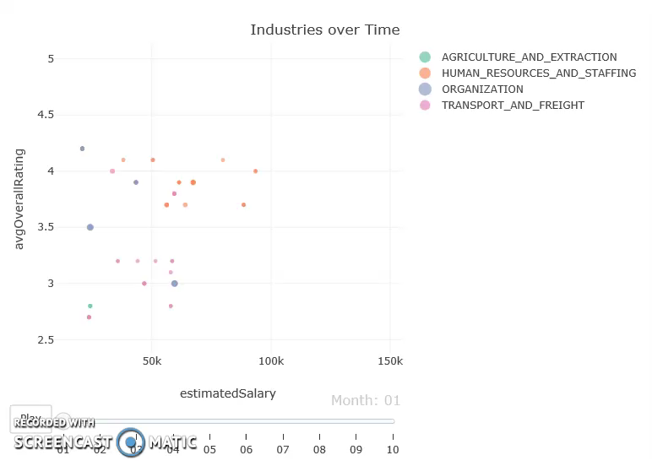
https://drive.google.com/open?id=1T__sCPYp3X2j2DxvfbH1c4TzyCM1vKWC

Slide 6
Getting a Job out of High School?
If you are planning on going to college and have some time to plan...
Agriculture and Extraction and Organization may be ones to steer clear of
Human Resources and Staffing along with Transport and Freight have high Employment velocities and are some of those industries least dependent on higher education.

